Slide 1
SVVNet Account

Slide 2
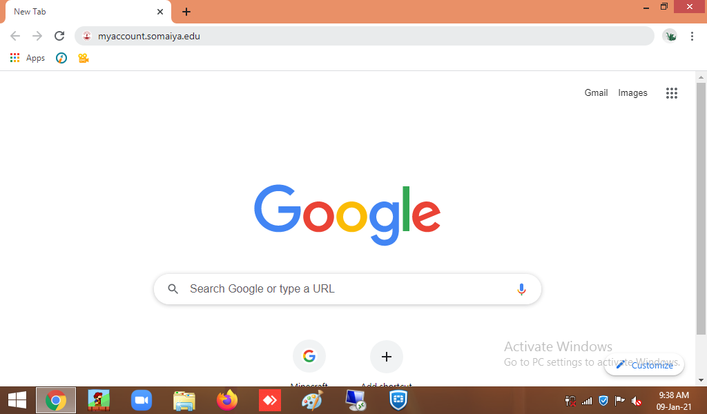
Visit myaccount.somaiya.edu portal

Slide 3
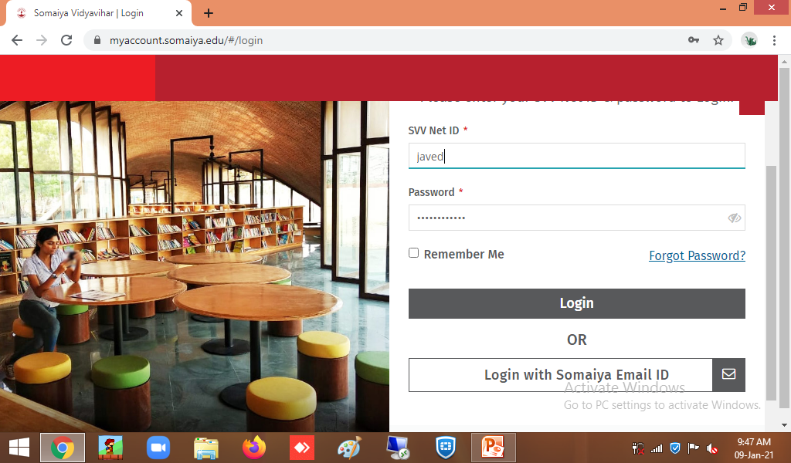
Type your svvnet Id

Slide 4
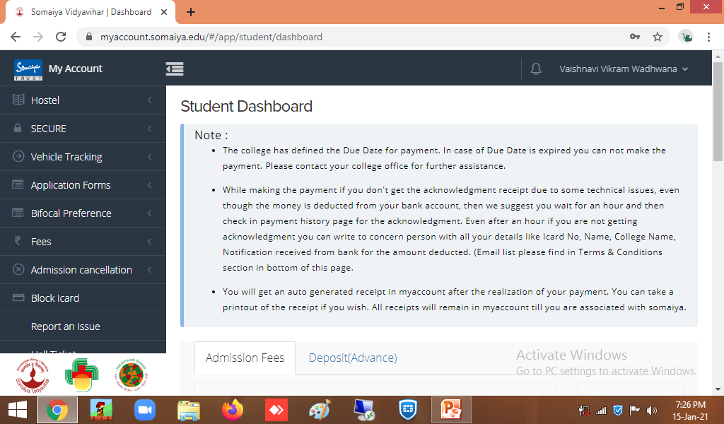
Your Dashboard

Slide 5
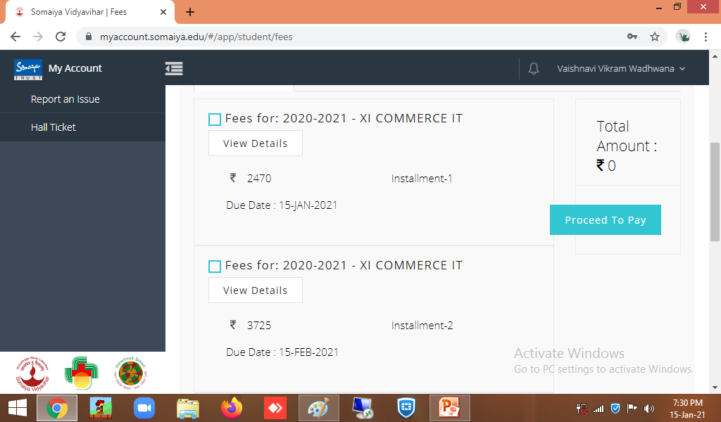

Slide 6
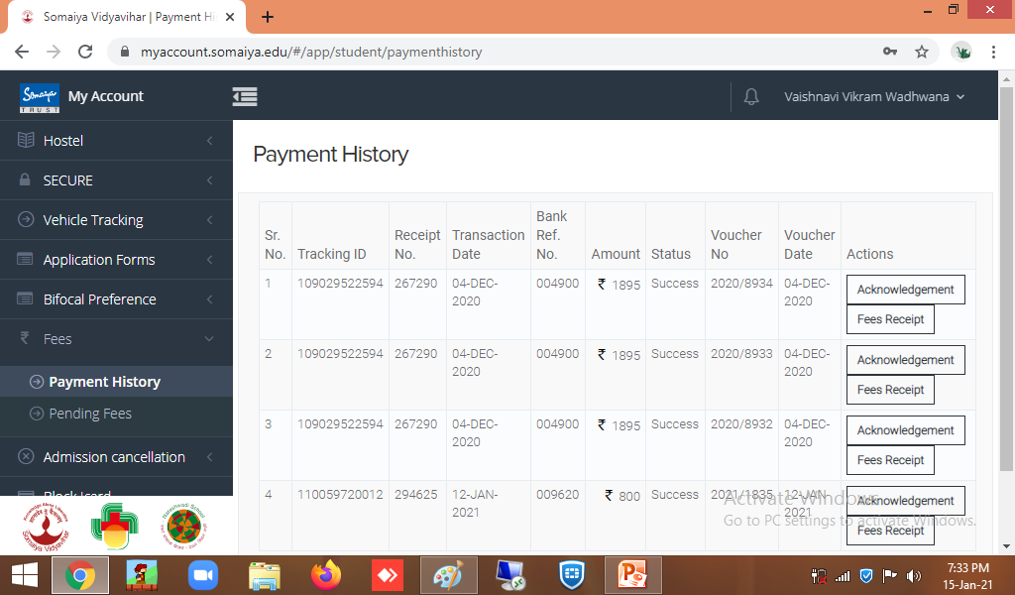

Slide 7
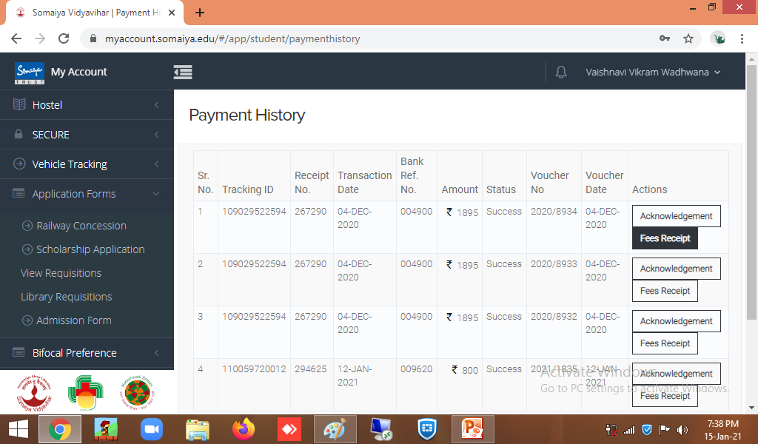

Slide 8
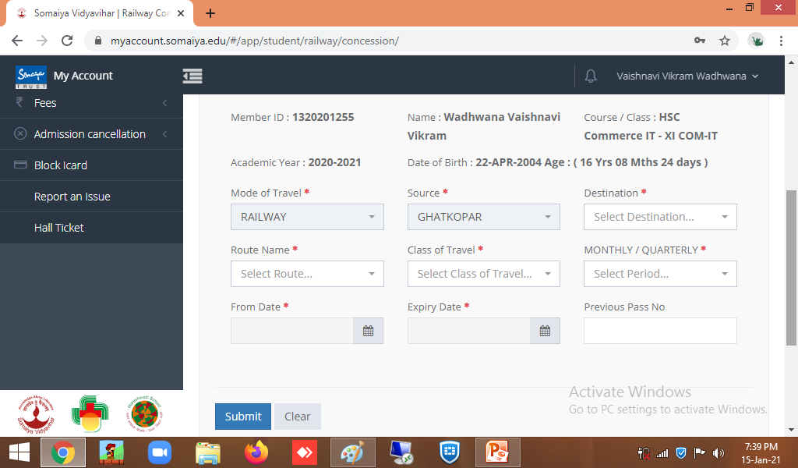

Slide 9
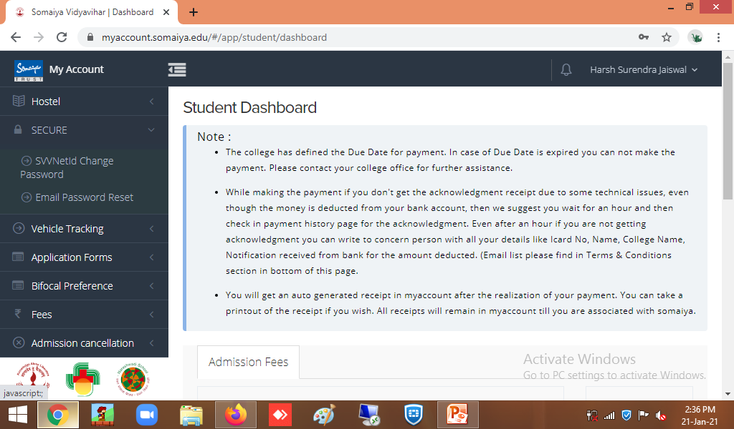
If you want to reset Password for your Somaiya email
Click on secure Option, you can see this screen

Slide 10
Click on Email Password Reset
Your registred mobile,Personal email will be displayed.
Click on Reset.
Text message will be sent on your mobile and personal emailid

Slide 11
If you have forgotten your SVVnetId Password

Slide 12
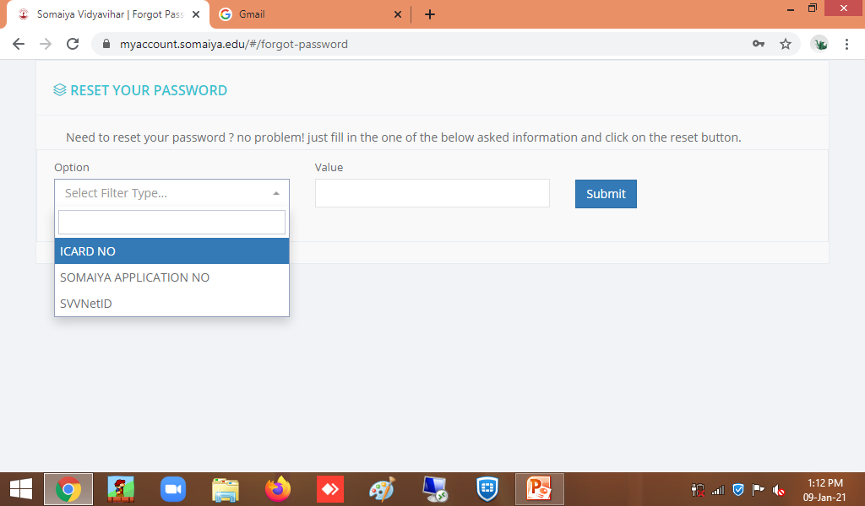

Slide 13
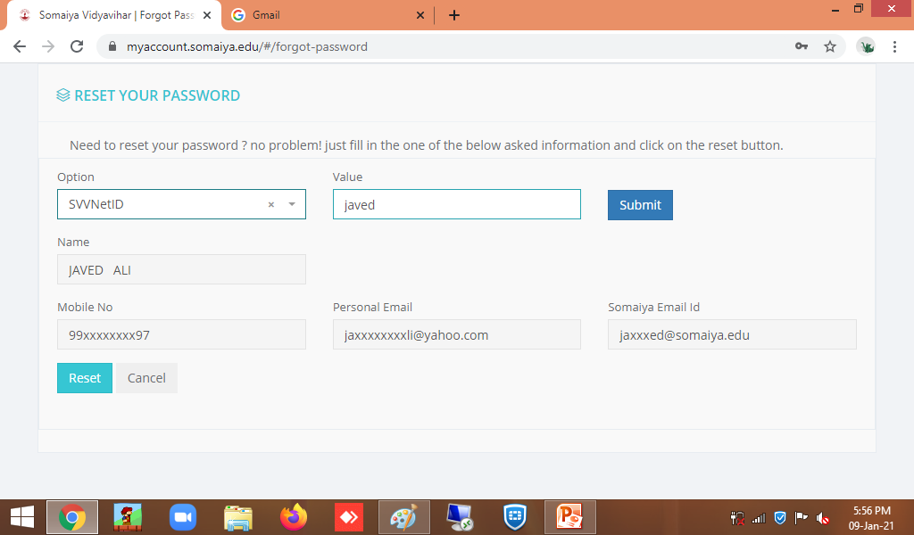

Slide 14
You will receive sms on registered Mobile number1, Email to Somaiya mail and Personal Email Id

Slide 15
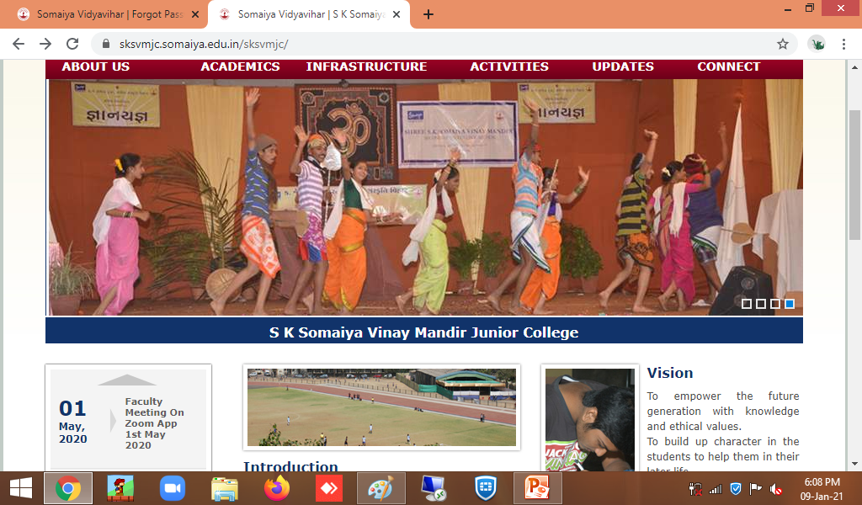
For Notice and Current Updates, Kindly keep visiting college Website https://sksvmjc.somaiya.edu.in/sksvmjc/

Slide 16
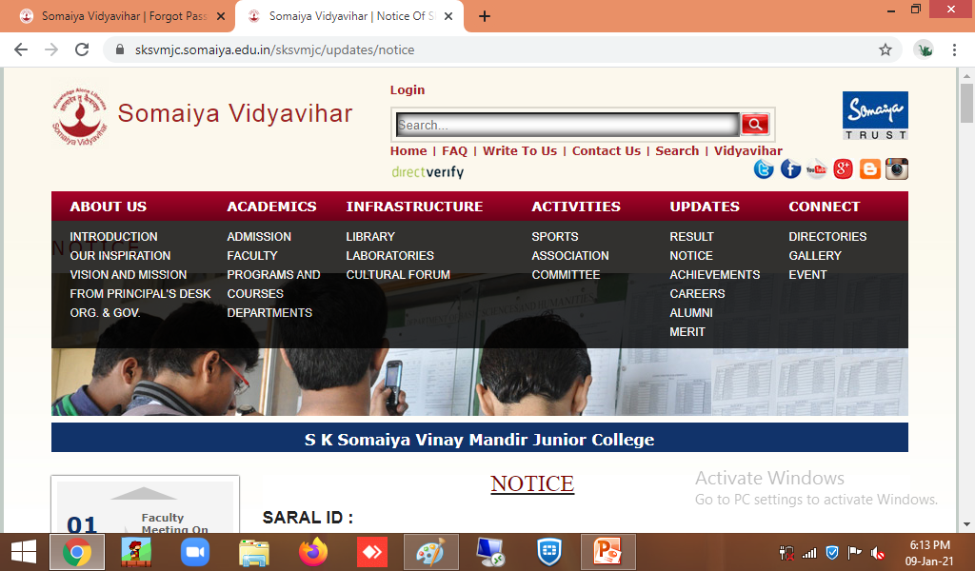
Click on updates tab ,then click on Notice

Slide 17
In case of Changing Registered Mobile Number or Personal Email :-
Contact :
Mr. Sanjay Tare Sir
E-mail : sanjay.tare@somaiya.edu
(All Science/Voc.Sci./Arts/MCVC)
Mr. Javed Ali Sir
E-mail : javed@somaiya.edu
(All Commerce/Voc.Com.)

Slide 18
Thank you

